Slide 1
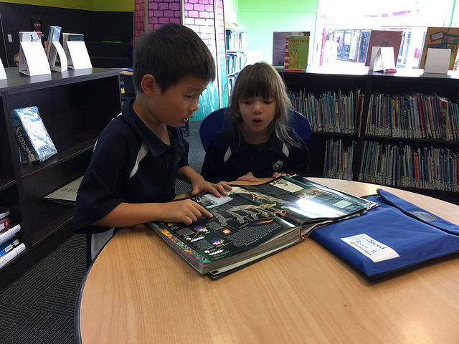
Learning to read and write at Gulf Harbour School

Slide 2
Reading
Our students learn about reading:
Reading is enjoyable!
You need to understand what you are reading.
You need to know how to figure out tricky words.
You need to fix mistakes, when you are reading
If you read out loud, you use a “talking voice”
The students learn how reading works:
That letters are pictures for sounds.
What sounds the letters make.
Sight words - words that they learn by heart.
The students learn about texts:
Texts contain key information and details
Texts can inform, entertain or persuade
Authors use language to create an impact on the audience

Slide 3
Reading at home with your child:
Read every day with your child.
Make it a cosy, relaxed experience - take turns, if the child is tired.
If English isn’t your first language, you and your child should look at all the pictures first and talk about what the text could be about. Use English, but if necessary translate or explain new words.
When the child struggles with a word, wait for 5 seconds, before you help.
Help your child to remember and use the strategies, we teach at school.
When the child solved the problem with the strategy, praise your child.

Slide 4
Our Reading Strategies can look like this ……

Slide 5
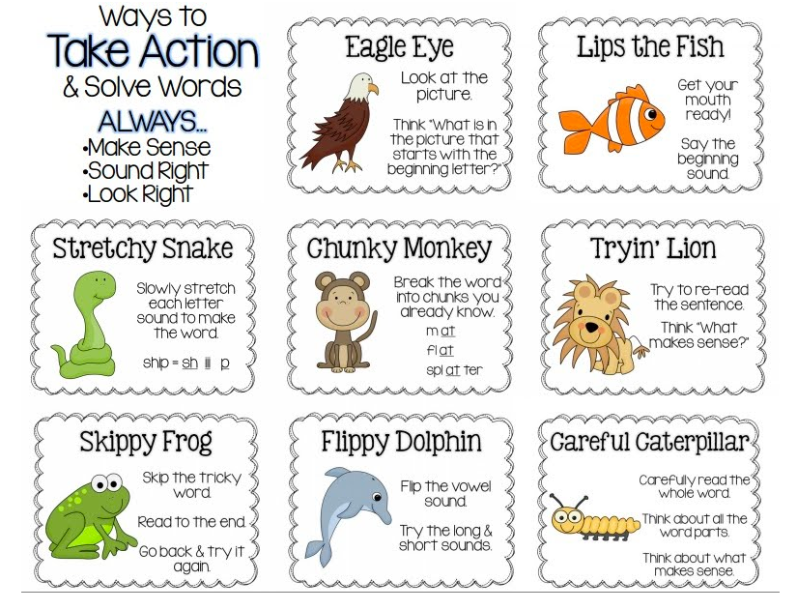

Slide 6
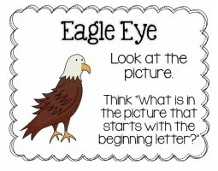
Look at the picture!
Our students use the pictures in a reader to figure out words.
Picture clues are important for young readers.
It is not cheating.
Say, “What can you see on the picture? Is there something
that begins with ….?”

Slide 7
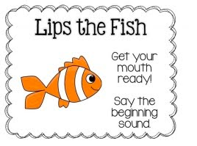
Say the beginning sound!
The children have to look at the first letter of a word
and think, “What sound does this letter make?”
The children have to make that sound.
Say,”What is the beginning sound, the first sound?
If necessary translate: first, next, last.

Slide 8
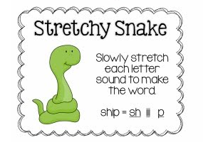
Stretch each sound slowly to make the word!
The students have to blend sounds into words:
They think about all the sounds in the word,
one after the other.
They slowly say the sounds, stretching them, so they can
listen to them.
Listen and say, “What word could it be?”

Slide 9
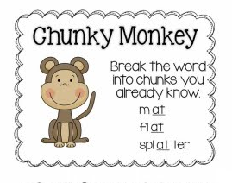
Break the word up!
The students look for parts in the word that they
know already. They say the sound the chunk makes and
combine it with the other sound(s).
Say, “There is a word hiding that you already know.
Can you find it?”

Slide 10
What if we get stuck?

Slide 11
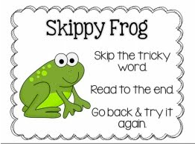
Keep going and then come back!
- What would make sense?
- What other strategy could we use?

Slide 12
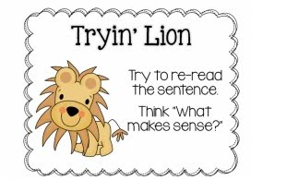
"Does it make sense?”
Sometimes readers come up with a word that starts with the same beginning sound, but is clearly wrong. Focus on the meaning of the text, what is the story about, what can I see on the picture? What would make sense?
Re-read the sentence!

Slide 13
“Does it sound right?”
Or, “Do you say it like this in English?”
We use the whole sentence and what we know about sentence structure to decide if we got a word right.
This can be tricky for ESOL students, but they develop an understanding of sentence structure, if we scaffold the right structure.
Re-read the sentence!

Slide 14
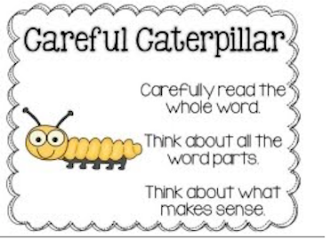
"Does it look right? -
“Does the sound I say match the word in the text?”
Sometimes readers use a word that makes sense in the sentence, but is not the right word. Focus on the sounds in the word.

Slide 15
More advanced readers might use reading strategies such as self-monitoring, predicting, visualising or making connections. There are no picture prompts anymore, but the processes behind these strategies also support the students to be successful readers.

Slide 16
What are Reading Rockets or the Colour Wheel?
The Reading Rocket programme is a step by step programme that becomes more complex with every new level. The levels range from magenta to gold.
You can tell what progress your child makes by how they progress through the reading rocket levels.
Remember: We want the children to understand (comprehend) what they read. They only move to the next level, when they understand the texts that they are reading.
That might take longer for some students, for example ESOL students, don’t be alarmed. Talk to your child’s teacher, if you are worried about a lack of progress.

Slide 17
Writing
In our junior classrooms the students learn to sound out words and write down the sounds they can hear, starting with the first sounds of words. It is great, if they write word “skeletons”.
If your child needs help, say, “What sounds can you hear?” and sound out the word slowly for your child. If your child can’t hear individual sounds, speak like a robot.
The students also learn to write sight words. These words are tricky to sound out and very common, the children need them often.
Practise reading and writing sight words at home.

Slide 19
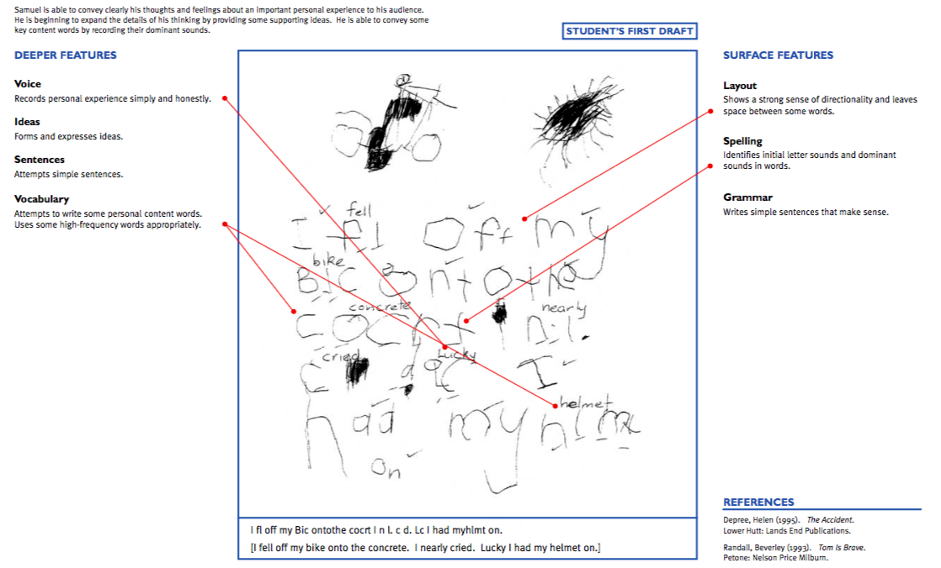
Year 1 writing exemplar
Level 1, 1

Slide 21
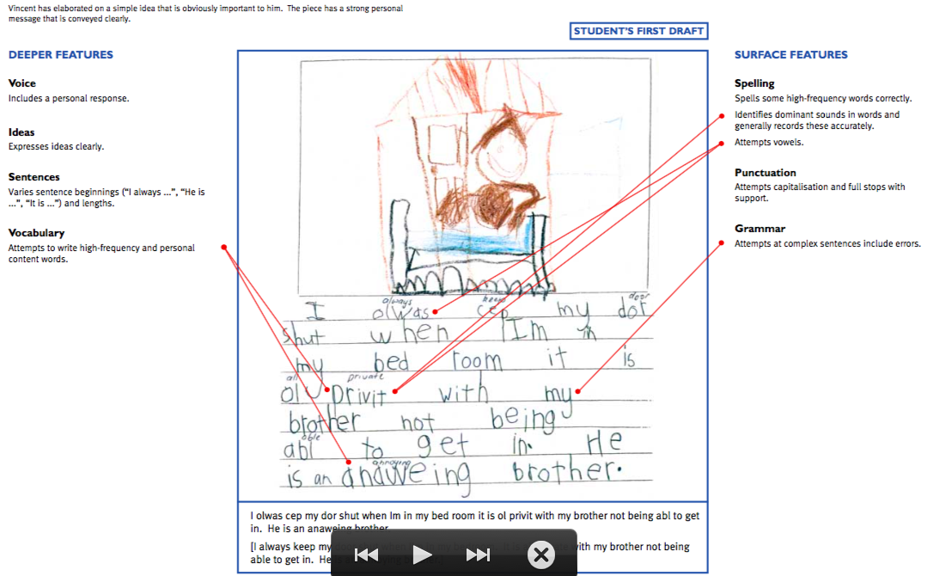
End of Year 1/ beginning of Year 2
Level 1, 2

Slide 22
When our children arrive in year 3 and 4, a lot more is expected of them.
They have to:
Write longer texts.
Plan for their texts and show an awareness of why they are writing a text. For example, “I am writing a story, because I want to entertain my readers.”
She an awareness of how to use language to gain the reader’s attention. For example, “I am using a simile to describe how angry my character in the story is. Tom was as angry as a hungry bear, after somebody stole his honey.
Use punctuation independently and apply their knowledge about spelling patterns and rules.

Slide 23
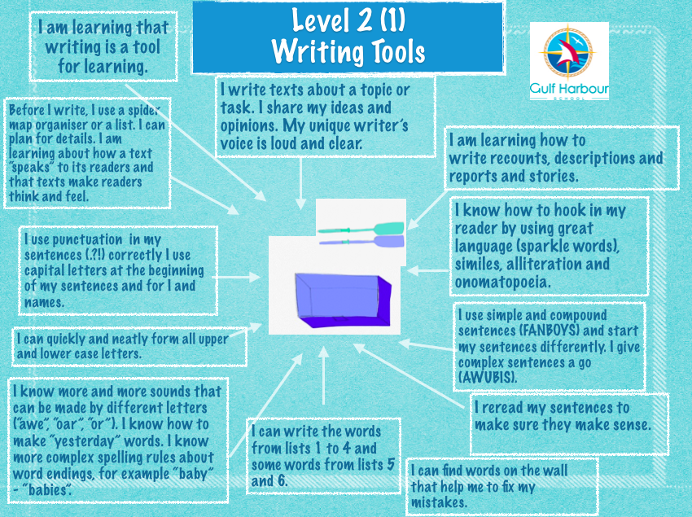

Slide 24
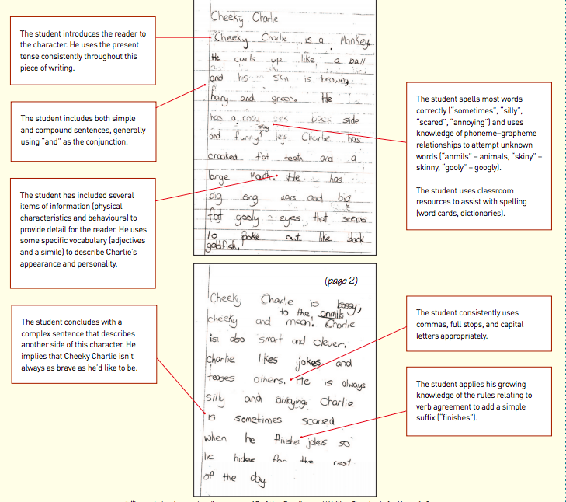

Slide 25
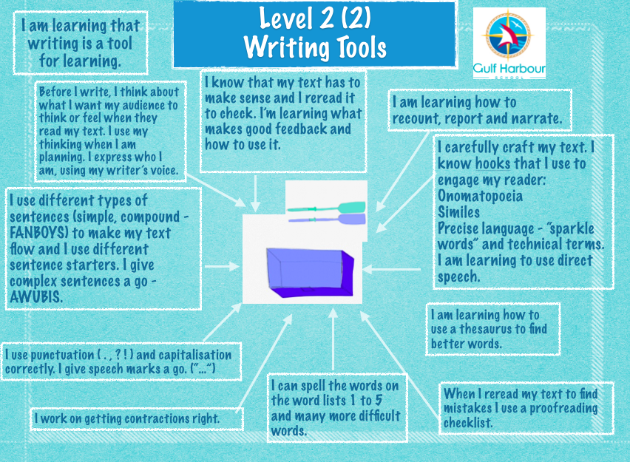

Slide 26
